Slide 1
Write a fuzzer in python

Slide 2
Writing a simple fuzzer in python
Simple mutation strategies
write random uint8 data to random position
bit flip in random position
insert random uint8 data to random posstion (increase length)
or smarter…

Slide 3
Writing a simple fuzzer in python
Tips: Character operations in python
Int to char
Char to int
String operations
a_int = 97
a_char = chr(a_int)
>a_char
‘a’
a_char = ‘a’
a_int = ord(a_char)
>a_int
97
Strcat:
str_a = ‘fu’
str_b = ‘dan’
str_c = str_a+str_b
‘fudan’

Slide 4
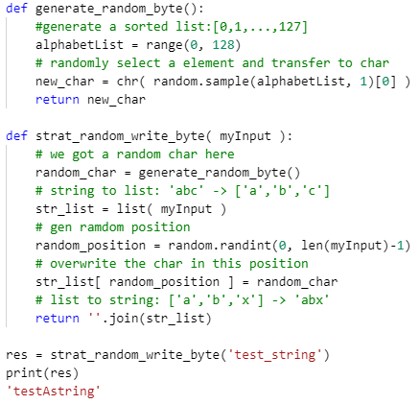
Writing a simple fuzzer in python
Code in python
Random char to random position
‘r’
?
‘r’

Slide 5
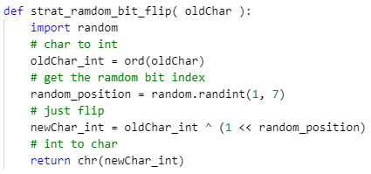
Writing a simple fuzzer in python
bit flip in random position
Code in python
0
1
1
0
0
0
0
1
‘a’
flip
0
1
1
0
0
0
1
1
‘c’

Slide 6
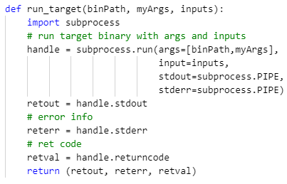
Writing a simple fuzzer in python
Run target program
Python2: subprocess.Popen
Python3: subprocess.run (recommend)
Code in python3

Slide 7
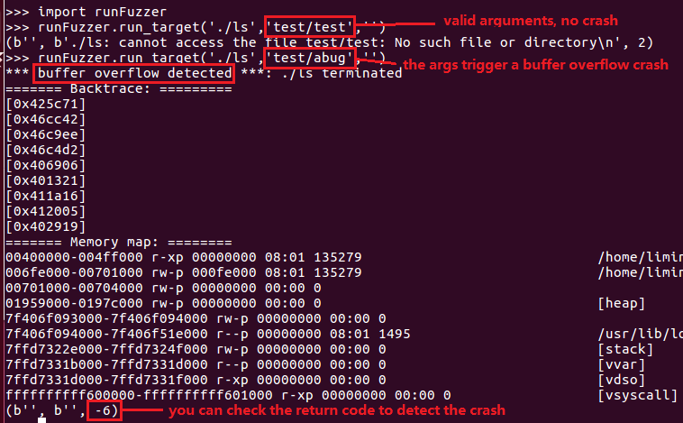
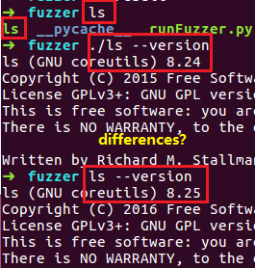
Writing a simple fuzzer in python
subprocess.run example
Target binary: ls (part of gnu coreutils)
64 bit binary
statically linked
Ref: https://www.gnu.org/software/coreutils/

Slide 8
Writing a simple fuzzer in python
Smarter
Use multithreading
Use multiprocessing
Mutation on known crash input

Slide 9
Writing a simple fuzzer in python
Very useful links
Step by step: https://jmcph4.github.io/2018/01/19/writing-a-simple-fuzzer-in-python/
Multithreading:https://www.tutorialspoint.com/python3/python_multithreading.htm

